Slide 1
GAN & Optimal Transportation
Zhizhong LI
Nov 23, 2017
Notes:
Mathematical notations and equations are important in this talk.

Slide 2
A geometric view of Optimal transportation and generative model
Na Lei, Kehua Sun, Li Cui, Shing-Tung Yau, David Xianfeng Gu
References
Santambrogio, Filippo. "Optimal transport for applied mathematicians." Birkäuser, NY (2015).
Villani, Cédric. Optimal transport: old and new. Vol. 338. Springer Science & Business Media, 2008.
Goodfellow, Ian, et al. "Generative adversarial nets." Advances in neural information processing systems. 2014.
Arjovsky, Martin, Soumith Chintala, and Léon Bottou. "Wasserstein generative adversarial networks." International Conference on Machine Learning. 2017.
Notes:
Notations of reference 1 and 2 are different (diff by a sign, sometimes), the paper follow the convention in 1, we use 2.
Not be surprised if you found a flipped sign.

Slide 3
Glossary
Concepts Definitions
Notes:
Many concepts need to understand before understand what thing the paper does

Slide 4

Ian Goodfellow
Research scientist at Google Brain

Slide 5
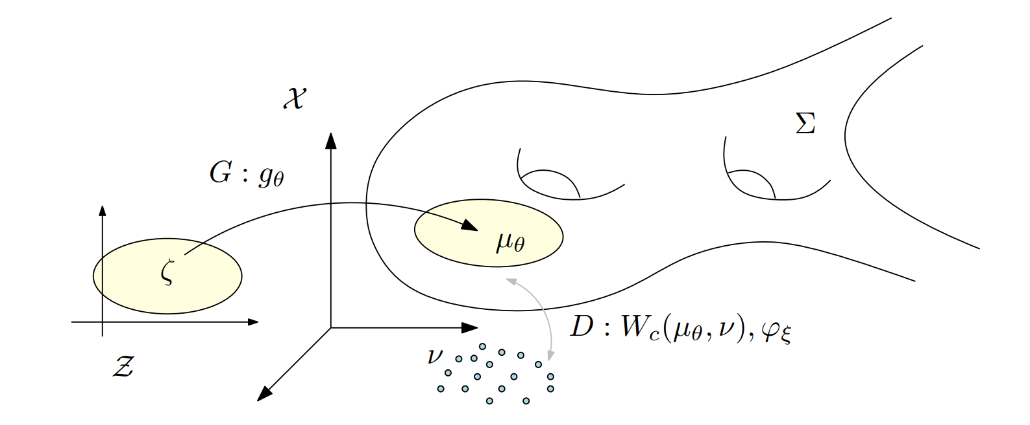
GAN
Notes:
Data as distribution
Generative model target: able to generate data distribution \nu
How GAN does it?
G map latent distribution \zeta to \mu
Compute the distance between \mu and \nu and minimize it
What distance, and how to compute distance?
JSD, by training a D to optimal.

Slide 6
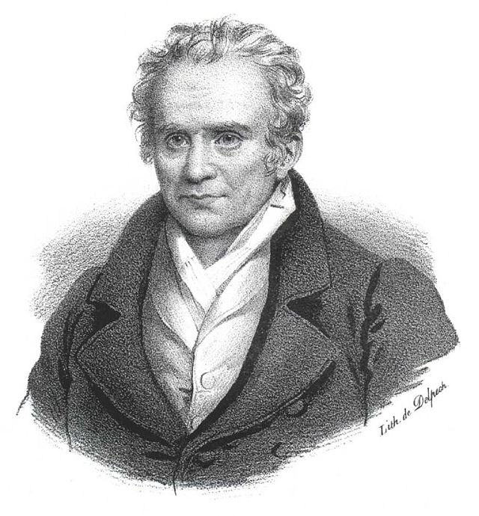
Monge
(9 May 1746 – 28 July 1818)
Inventor of descriptive geometry (mathematical basis of technical drawing)
Father of differential geometry
Minister of the Marine
Notes:
As a scientist with engineering background, he raised the following problem

Slide 7
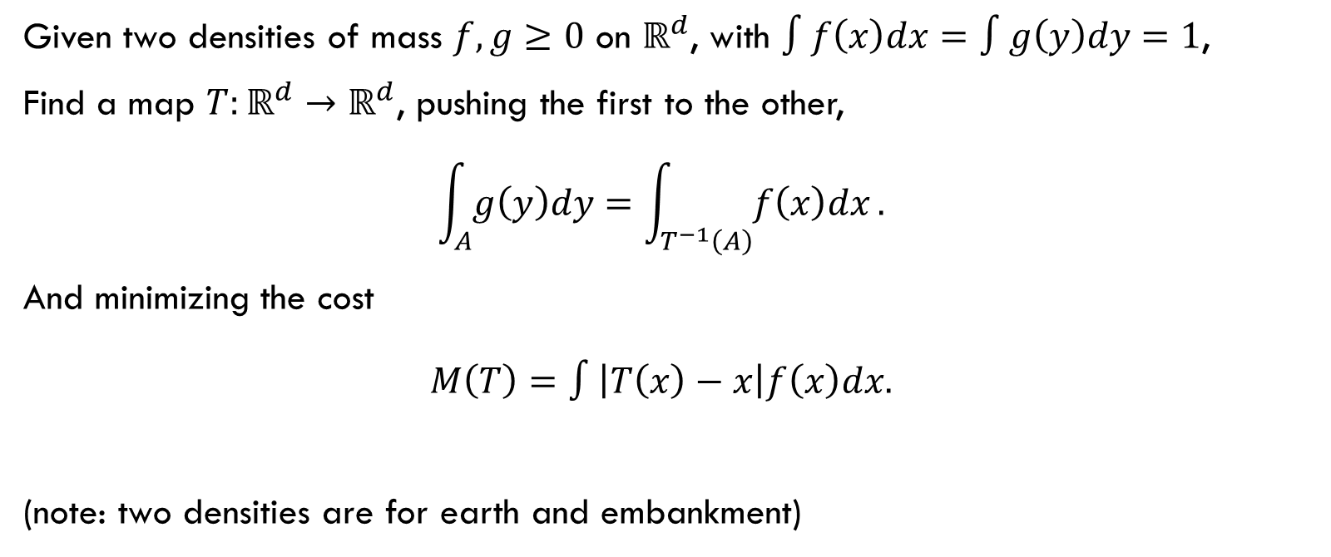
Monge’s Problem
Given two densities of mass $f, g≥0$ on $ℝ^{d}$, with $∫f\left(x\right)dx=∫g\left(y\right)dy=1$,
Find a map $T:ℝ^{d}→ℝ^{d}$, pushing the first to the other, $\int_{A}{g\left(y\right)dy}=\int_{T^{−1}\left(A\right)}{f\left(x\right)dx}.$
And minimizing the cost $M\left(T\right)=∫\left|T\left(x\right)−x\right|f\left(x\right)dx.$
(note: two densities are for earth and embankment)
Notes:
Mass conservation law

Slide 8

Push-forward operator
If $μ$ is a Borel measure, $T:X→Y$ is a Borel map.
Then the push-forward $T_{\#}μ$ of $μ$ is a measure on $Y$, defined by $\left(T_{\#}μ\right)\left[A\right]=μ\left[T^{−1}\left(A\right)\right].$
Notes:
Now we formulate the mass conservative law using the language of measure.

Slide 9

Measure-Preserving Map
$X, Y$: metric spaces with probability measures $μ, ν$, respectively.
$T:X→Y$ is measure preserving if $∀$ measurable set $B⊂Y$, $μ\left(T^{−1}\left(B\right)\right)=ν\left(B\right),$
can be written as $T_{\#}μ=ν.$
Notes:
It get another name, measure-preserving map

Slide 10

Monge’s Optimal Mass Transport
Given a transportation cost function $c:X×Y→ℝ$, find the measure preserving map $T:X→Y$ that minimizes the total transportation cost $W\left(μ,ν\right)=\inf_{T: T_{\#}μ=ν}\int_{X}{c\left(x,T\left(x\right)\right)dμ\left(x\right)}.$
Notes:
Reformulate Monge's problem using measure language

Slide 11
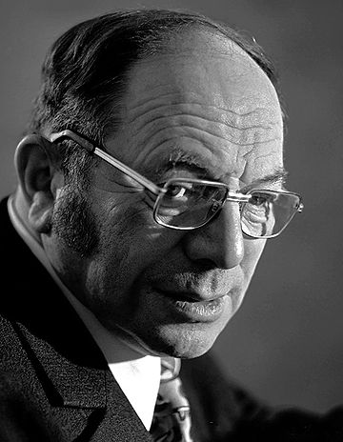
Kantorovich
(19 January 1912 – 7 April 1986)
Founder of linear programming
Stalin Prize in 1949
Nobel Memorial Prize in Economic Sciences in 1975
Notes:
Another formulation of the problem, a relaxation version

Slide 12
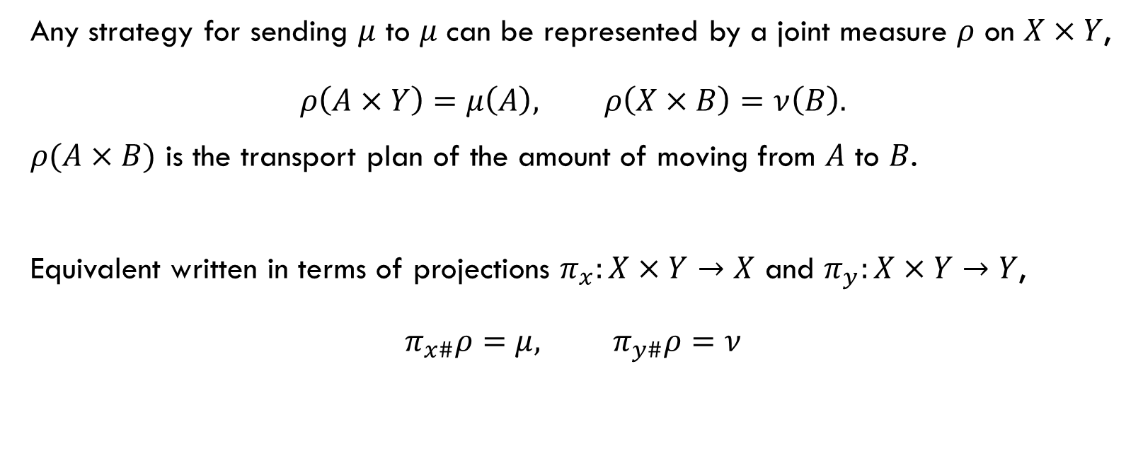
Transportation Plan
Any strategy for sending $μ$ to $μ$ can be represented by a joint measure $ρ$ on $X×Y$, $ρ\left(A×Y\right)=μ\left(A\right), ρ\left(X×B\right)=ν\left(B\right).$
$ρ(A×B)$ is the transport plan of the amount of moving from $A$ to $B$.
Equivalent written in terms of projections $π_{x}:X×Y→X$ and $π_{y}:X×Y→Y$, $π_{x\#}ρ=μ, π_{y\#}ρ=ν$
Notes:
Note the difference, the movement strategy of transport plan is more general than the movement strategy measure preserving map:
One point of source to many points of destination.
Note also that X and Y need not to be in the same ambient space.

Slide 13
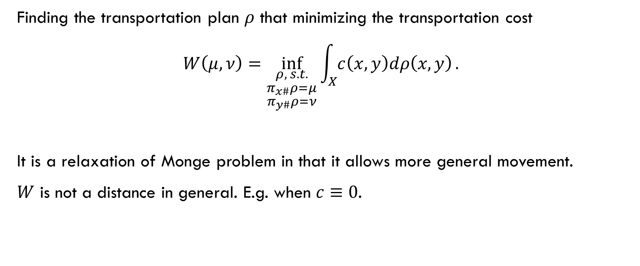
Kantorovich’s Problem
Finding the transportation plan $ρ$ that minimizing the transportation cost $W\left(μ,ν\right)=\inf_{\begin{aligned}\begin{aligned}ρ, s.t. \\ π_{x\#}ρ=μ\end{aligned} \\ π_{y\#}ρ=ν\end{aligned}}{\int_{X}{c\left(x,y\right)dρ\left(x,y\right)}}.$
It is a relaxation of Monge problem in that it allows more general movement.
$W$ is not a distance in general. E.g. when $c≡0$.
Notes:
To make it be a distance between distributions, need constraint on the cost

Slide 14
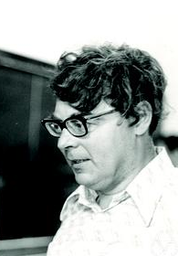
Roland Dobrushin
(July 20, 1929 – November 12, 1995)
A mathematician who made important contributions to probability theory, mathematical physics, and information theory.
The name "Wasserstein distance" was coined by R. L. Dobrushin in 1970.

Slide 15
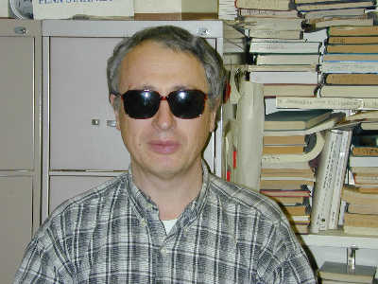
Leonid Vaseršteĭn
Professor of Mathematics at Penn State University
He is well known for providing a simple proof of the Quillen–Suslin theorem, a result in commutative algebra.

Slide 16
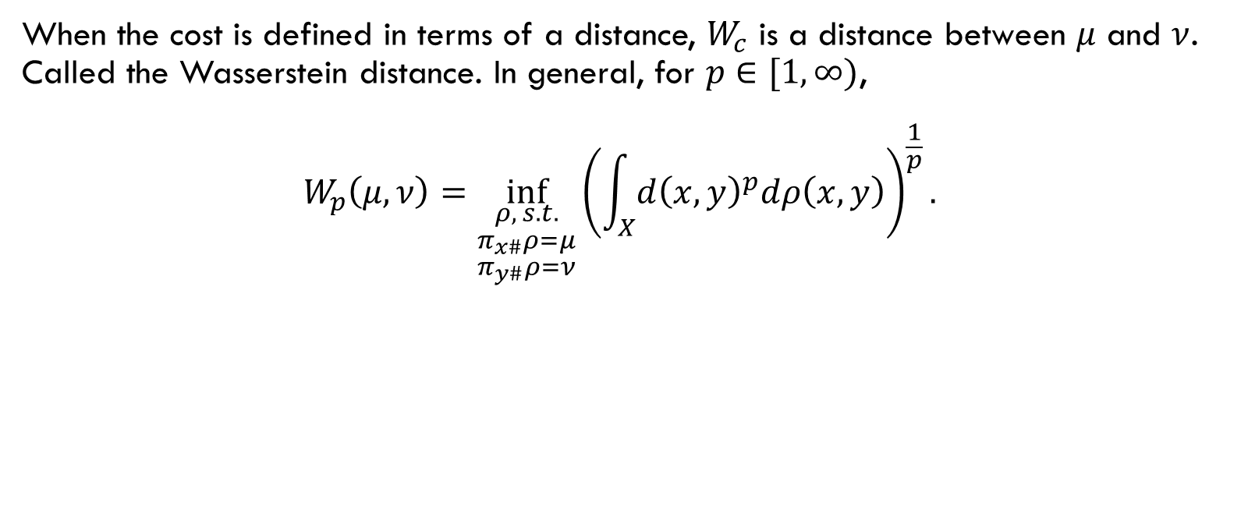
Wasserstein distance
When the cost is defined in terms of a distance, $W_{c}$ is a distance between $μ$ and $ν$. Called the Wasserstein distance. In general, for $p∈[1,∞)$, $W_{p}\left(μ,ν\right)=\inf_{\begin{aligned}\begin{aligned}ρ, s.t. \\ π_{x\#}ρ=μ\end{aligned} \\ π_{y\#}ρ=ν\end{aligned}}{{\left(\int_{X}{{d\left(x,y\right)}^{p}dρ\left(x,y\right)}\right)}^{\frac{1}{p}}}.$
Notes:
p=1 is the one we met above

Slide 17
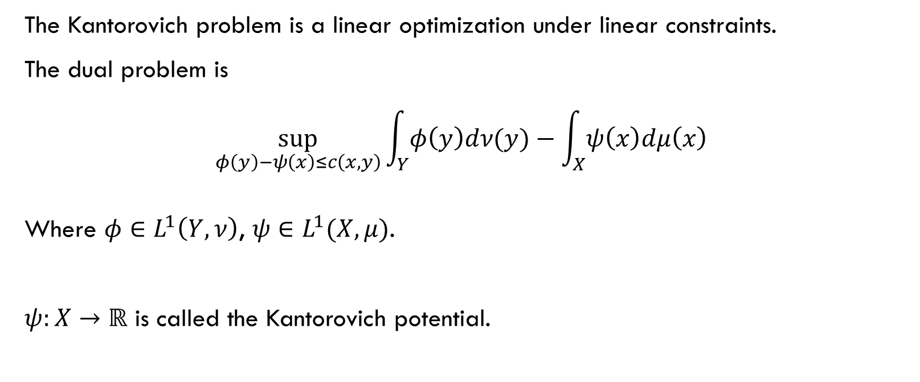
Dual Kantorovich Problem
The Kantorovich problem is a linear optimization under linear constraints.
The dual problem is $\sup_{φ\left(y\right)−ψ\left(x\right)≤c\left(x,y\right)}{\int_{Y}{φ\left(y\right)dν(y)}−\int_{X}{ψ\left(x\right)dμ\left(x\right)}}$
Where $φ∈L^{1}\left(Y,ν\right)$, $ψ∈L^{1}(X,μ)$.
$ψ:X→ℝ$ is called the Kantorovich potential.
Notes:
Kantorovich: founder of linear programming.
Given a problem, we look at its dual.
Can get this through tools in linear programming (and other tools of course, not the preliminary dual theorems)
Instead, we understand this dual problem via an example.

Slide 18
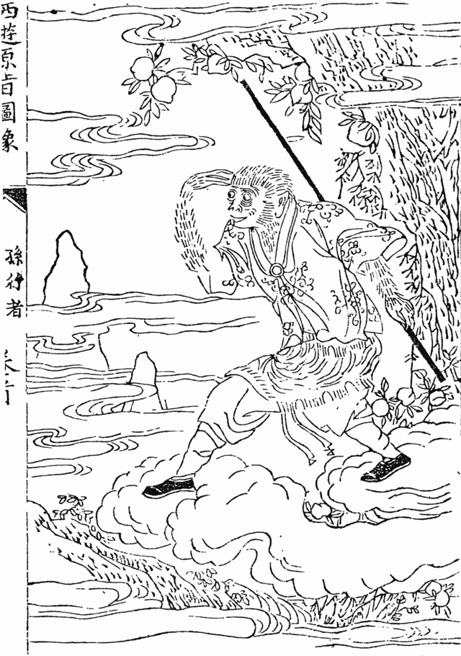
Sun Wukong
72 Di Sha transformation
Jin Dou Cloud
Eye of Truth
Notes:
The most important part is demonstrated by the help of Wukong.

Slide 19

Example Explained
A company managing both bakeries (located at $x_{i}$) and cafés (located at $y_{j}$).
The transportation cost of sending bread from bakery $x_{i}$ to café $y_{j}$ is $c\left(x_{i},y_{j}\right)$.
The primal Kantorovich problem is to minimize transportation cost.
Notes:
Take care of transportation by self

Slide 20
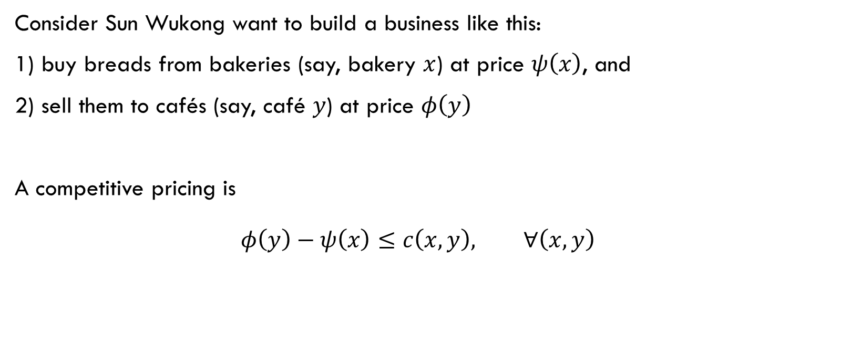
Example Explained – Competitive pricing
Consider Sun Wukong want to build a business like this:
1) buy breads from bakeries (say, bakery $x$) at price $ψ\left(x\right)$, and
2) sell them to cafés (say, café $y$) at price $φ\left(y\right)$
A competitive pricing is $φ\left(y\right)−ψ\left(x\right)≤c\left(x,y\right), ∀\left(x,y\right)$
Notes:
Business plan
Author: Wukong

Slide 21

Example Explained – inequality
With the help of Wukong, the transportation cost for the company is lower than the previous optimal transport plan $\sup_{φ−ψ≤c}{\int_{Y}{φ\left(y\right)dν\left(y\right)−\int_{X}{ψ\left(x\right)dμ\left(x\right)}}≤}\inf_{\begin{aligned}\begin{aligned}ρ, s.t. \\ π_{x\#}ρ=μ\end{aligned} \\ π_{y\#}ρ=ν\end{aligned}}{\int_{X}{c\left(x,y\right)dρ\left(x,y\right)}}$
Notes:
Left first term, buying cost of company’s café department
Left second term, selling profits of company’s bakery department
Right, the optimal transport plan by the company itself

Slide 22
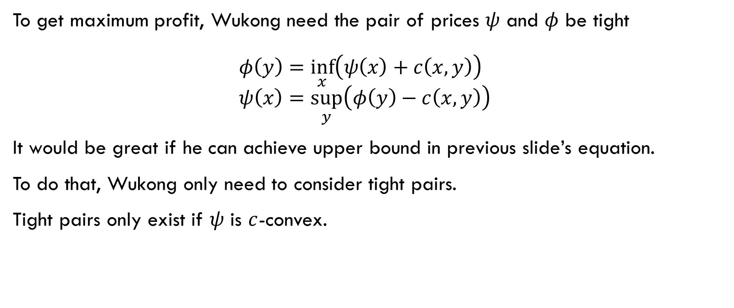
Example Explained – tight price
To get maximum profit, Wukong need the pair of prices $ψ$ and $φ$ be tight $φ\left(y\right)=\inf_{x}\left(ψ\left(x\right)+c\left(x,y\right)\right)$ $ψ\left(x\right)=\sup_{y}\left(φ\left(y\right)−c\left(x,y\right)\right)$
It would be great if he can achieve upper bound in previous slide’s equation.
To do that, Wukong only need to consider tight pairs.
Tight pairs only exist if $ψ$ is $c$-convex.
Notes:
Business is greedy

Slide 23
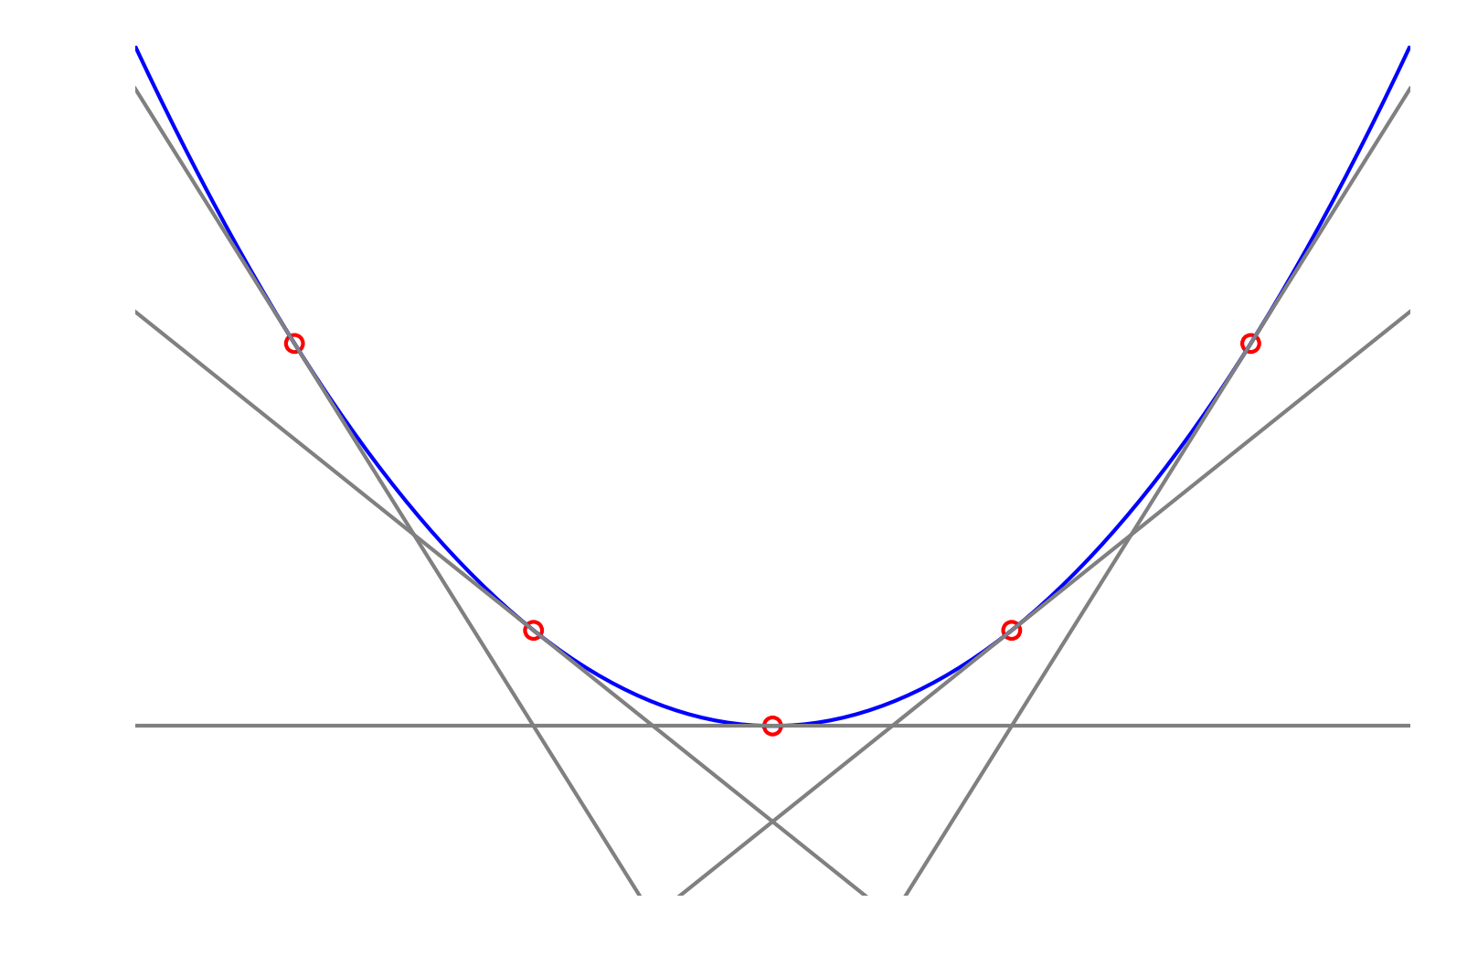
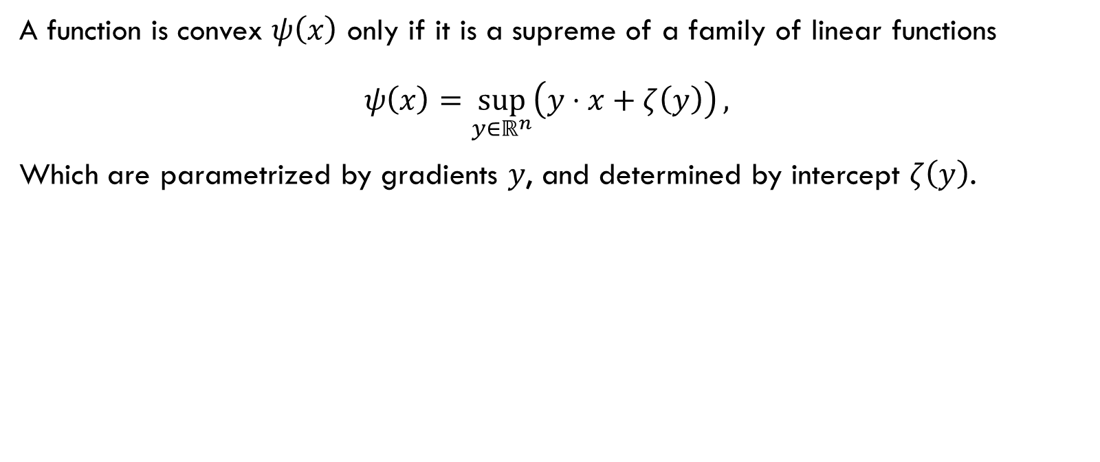
convex
A function is convex $ψ\left(x\right)$ only if it is a supreme of a family of linear functions $ψ\left(x\right)=\sup_{y∈ℝ^{n}}\left(y⋅x+ζ\left(y\right)\right),$
Which are parametrized by gradients $y$, and determined by intercept $ζ\left(y\right)$.
Notes:
Another definition of convexity.
Such defined functions are convex
$⇐$ Convex functions can be written as the envelop of tangent plane

Slide 24
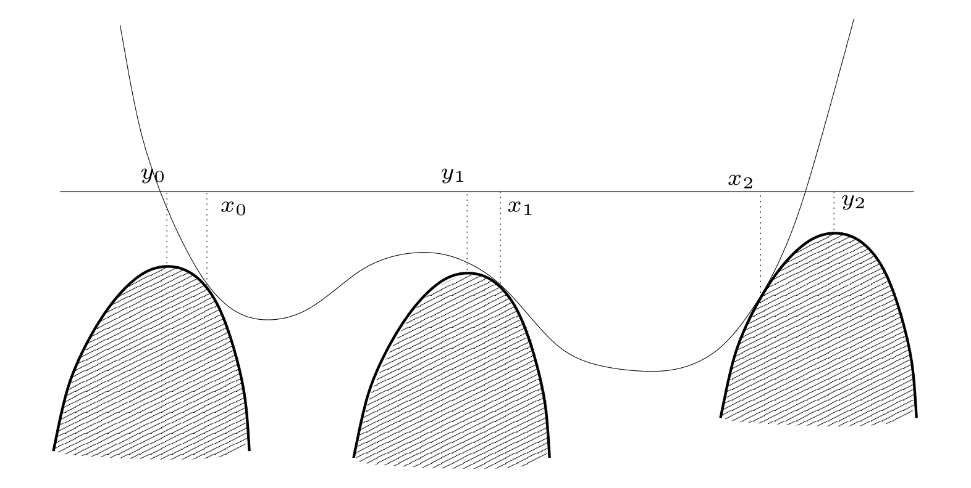

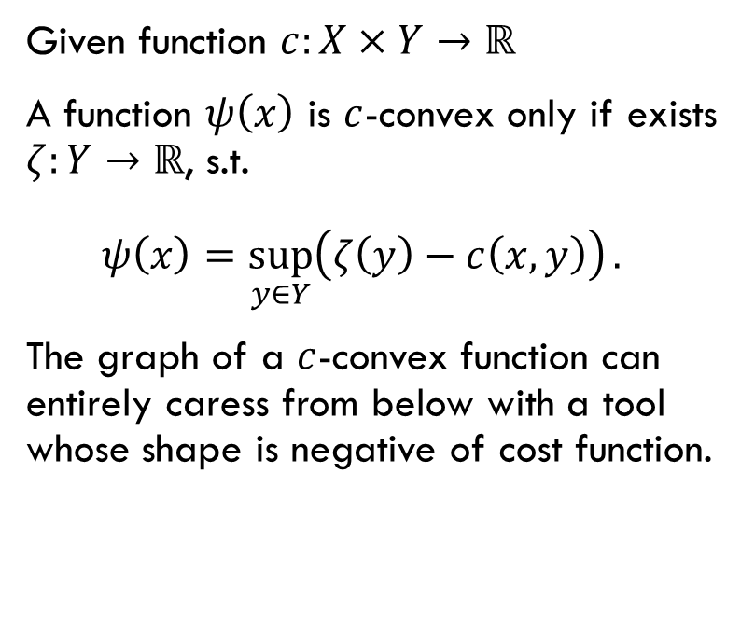
$c$-convex
Given function $c:X×Y→ℝ$
A function $ψ\left(x\right)$ is $c$-convex only if exists $ζ:Y→ℝ$, s.t. $ψ\left(x\right)=\sup_{y∈Y}\left(ζ\left(y\right)−c\left(x,y\right)\right).$
The graph of a $c$-convex function can entirely caress from below with a tool whose shape is negative of cost function.
Notes:
Caress with fingers :P
The shape is for each fixed y.

Slide 25
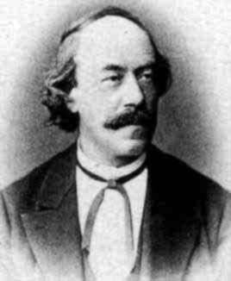
Lipschitz
(14 May 1832 – 7 October 1903)
Known for
Lipschitz continuity
Lipschitz integral condition
Lipschitz quaternion
Notes:
German mathematician who made contributions to mathematical analysis and differential geometry, as well as number theory, algebras with involution and classical mechanics.

Slide 26
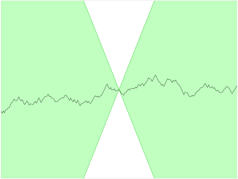


Example of $c$-Convexity
$c=−x⋅y$, convex functions
$c\left(x,y\right)=d\left(x,y\right)=\left|x−y\right|$, $1$-Lipschitz functions
Notes:
Caress with plane
Caress with arrow pointer

Slide 27


$c$-transform
For $c$-convex function $ψ\left(x\right)$, the $c$-transform is $ψ^{c}\left(y\right)=\inf_{x∈X}\left(ψ\left(x\right)+c\left(x,y\right)\right).$
$c=−x⋅y$, Legendre transform
$c\left(x,y\right)=\left|x−y\right|$, identity functor
$φ=ψ^{c}$ for tight pairs $\left(ψ,φ\right)$
Notes:
Then we can get price at café from the price at bakery.

Slide 28
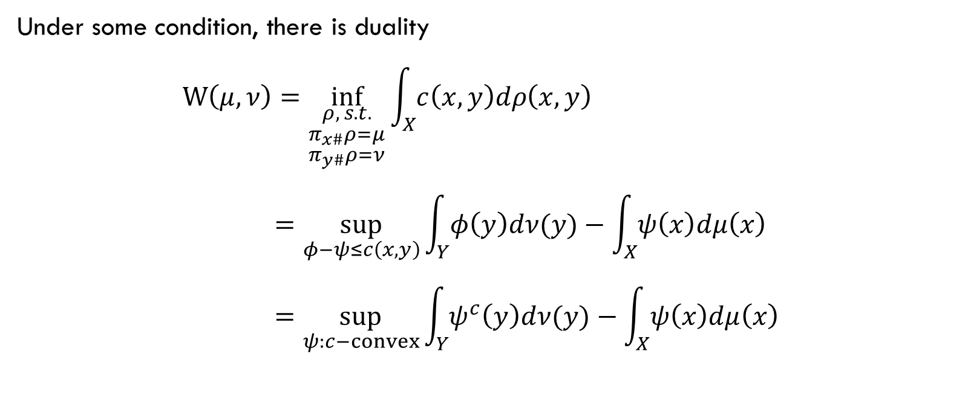
Kantorovich Duality
Under some condition, there is duality $W\left(μ,ν\right)=\inf_{\begin{aligned}\begin{aligned}ρ, s.t. \\ π_{x\#}ρ=μ\end{aligned} \\ π_{y\#}ρ=ν\end{aligned}}{\int_{X}{c\left(x,y\right)dρ\left(x,y\right)}}$ $=\sup_{φ−ψ≤c\left(x,y\right)}{\int_{Y}{φ\left(y\right)dν(y)}−\int_{X}{ψ\left(x\right)dμ\left(x\right)}}$ $=\sup_{ψ:c−convex}{\int_{Y}{ψ^{c}\left(y\right)dν(y)}−\int_{X}{ψ\left(x\right)dμ\left(x\right)}}$
Notes:
First equation, definition of W distance
Second equation, Wukong’s business plan
Third equation, only consider tight pairs of c-convex functions
The dual form is solvable (variational form)

Slide 29

Kantorovich potential
$ψ:X→ℝ$ is called the Kantorovich potential.
Once we know the optimal $ψ$, we know the optimal cost.
Notes:
Remember $ψ$ is the price at bakery.
Some define the optimal $ψ$ as Kantorovich potential.
We know the cost, but we do not know the transportation plan.

Slide 30
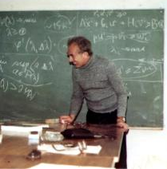
G. S. Rubinstein
Professor
Notes:
Now we can apply the previous result

Slide 31
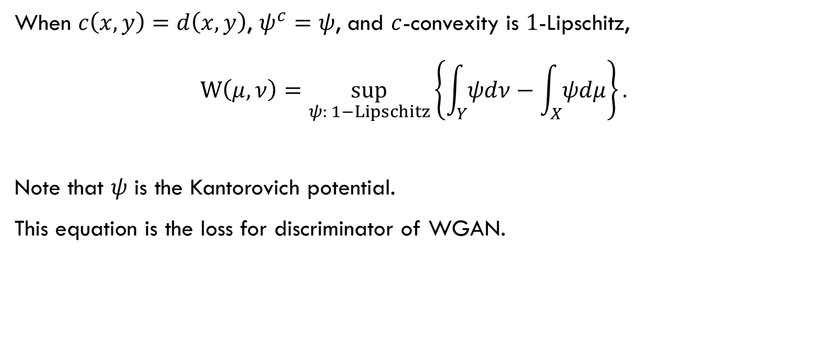
Kantorovich-Rubinstein formula
When $c\left(x,y\right)=d\left(x,y\right)$, $ψ^{c}=ψ$, and $c$-convexity is $1$-Lipschitz, $W\left(μ,ν\right)=\sup_{ψ: 1−Lipschitz}\left\{\int_{Y}{ψdν}−\int_{X}{ψdμ}\right\}.$
Note that $ψ$ is the Kantorovich potential.
This equation is the loss for discriminator of WGAN.
Notes:
We will talk about WGAN later.

Slide 32
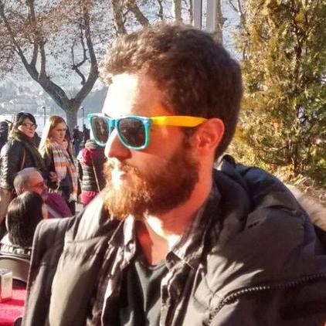
Martin Arjovsky
PhD student at the Courant Institute of Mathematical Sciences.
Notes:
We come back to GAN, this time, WGAN.

Slide 33
WGAN

Slide 34
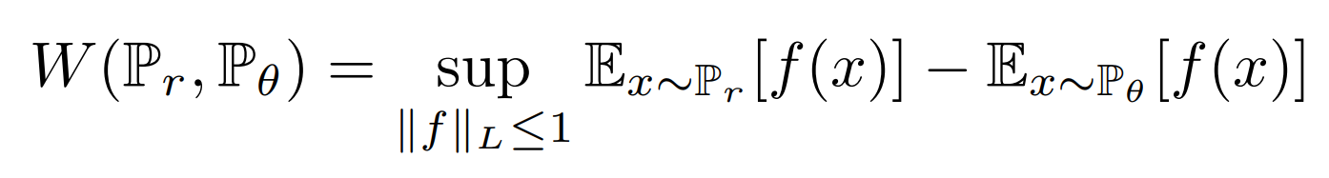

WGAN Discriminator Loss
$ℙ_{r}=ν$: data distribution
$ℙ_{θ}=μ_{θ}$: generated distribution
$f=ψ$: discriminator network with weight clipping
Notes:
1-Lipschitz condition is done by weight clipping,
And by directly gradient penalty in the improved WGAN.

Slide 35
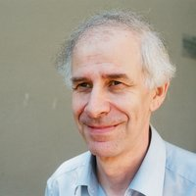
Brenier
(born January 1st 1957)
Centre de mathématiques Laurent Schwartz,
Ecole Polytechnique, FR-91128 Palaiseau, France
Notes:
For special cost, there are better representation of solution

Slide 36
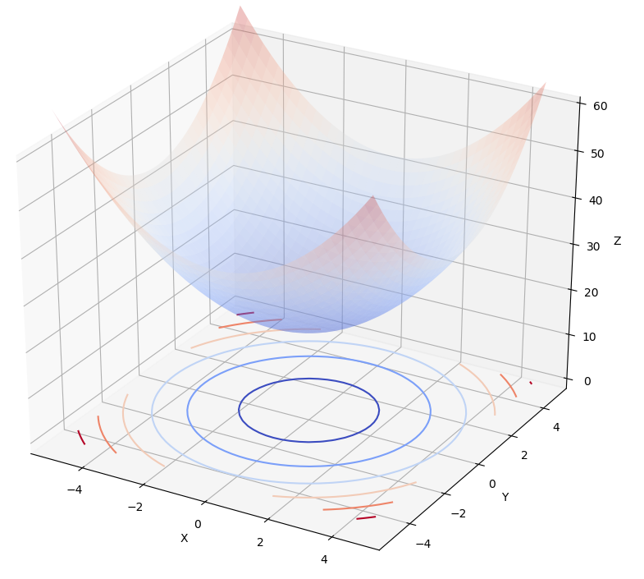
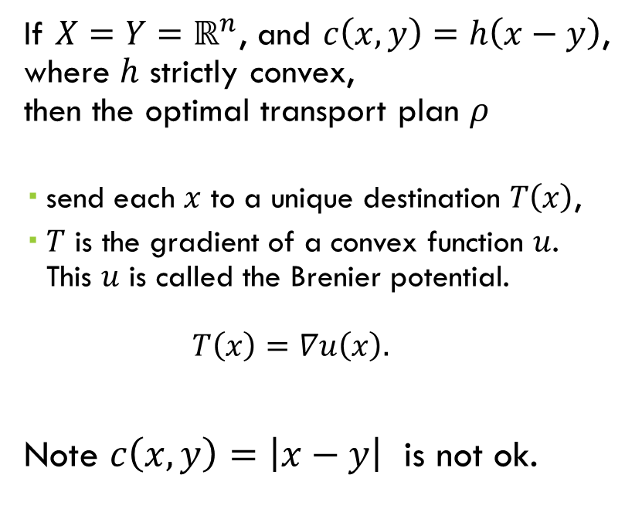


Brenier potential
If $X=Y=ℝ^{n}$, and $c\left(x,y\right)=h\left(x−y\right)$, where $h$ strictly convex, then the optimal transport plan $ρ$
send each $x$ to a unique destination $T\left(x\right)$,
$T$ is the gradient of a convex function $u$. This $u$ is called the Brenier potential. $T\left(x\right)=∇u\left(x\right).$
Note $c\left(x,y\right)=\left|x−y\right|$ is not ok.
$$x$$
$$∇u\left(x\right)$$
Notes:
Two points:
Unique destination
Potential representation of transportation map
Constraint:
X and Y lie in the same Euclidean space
$h$ strictly convex

Slide 37

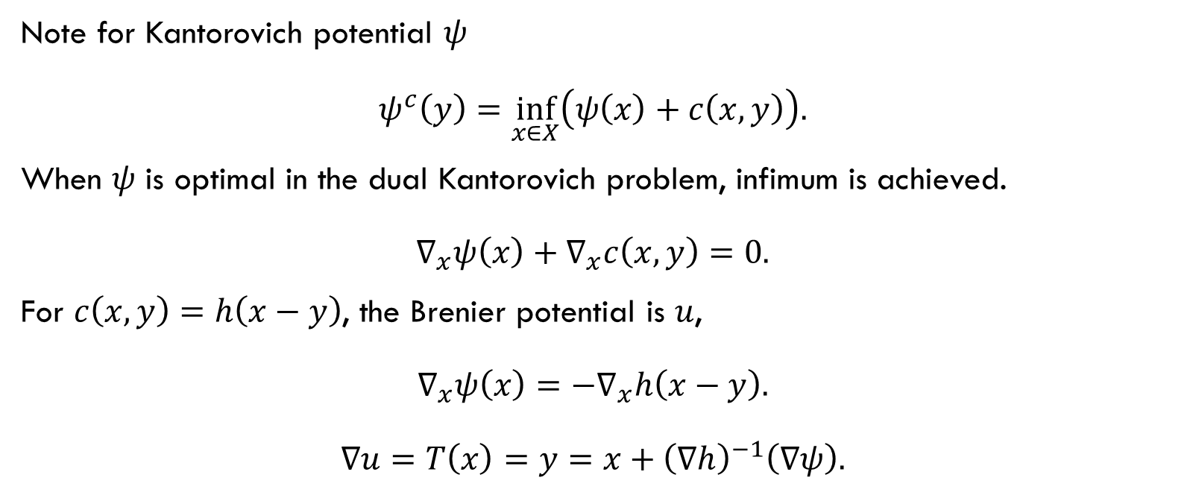
Relation between potentials $ψ$ and $u$
Note for Kantorovich potential $ψ$ $ψ^{c}\left(y\right)=\inf_{x∈X}\left(ψ\left(x\right)+c\left(x,y\right)\right).$
When $ψ$ is optimal in the dual Kantorovich problem, infimum is achieved. $∇_{x}ψ\left(x\right)+∇_{x}c\left(x,y\right)=0.$
For $c\left(x,y\right)=h\left(x−y\right)$, the Brenier potential is $u$, $∇_{x}ψ\left(x\right)=−∇_{x}h\left(x−y\right).$ $∇u=T\left(x\right)=y=x+{\left(∇h\right)}^{−1}\left(∇ψ\right).$
Notes:
Once we know Kantorovich potential, we can compute the W distance.
Once we know Brenier potential, we can even write the optimal transportation map $T$.
With this relation, we can also get optimal transportation map with Kantorovich potential.

Slide 38
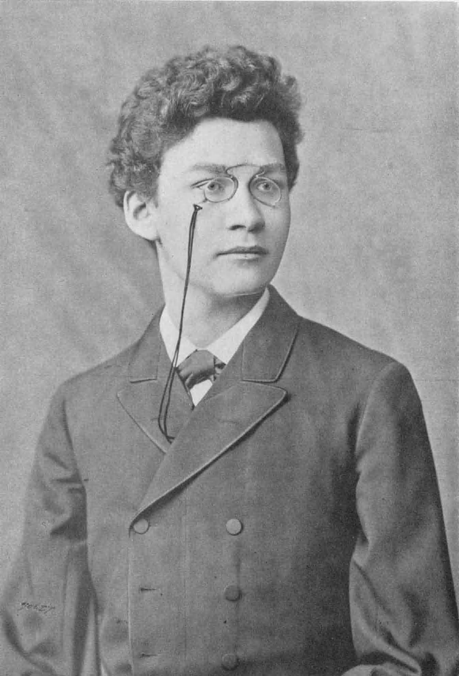
Minkovski
(22 June 1864 – 12 January 1909)
Created and developed the geometry of numbers.
He showed that his former student's, Albert Einstein, special theory of relativity could be understood geometrically as a theory of four-dimensional space–time, since known as the "Minkowski spacetime".
Notes:
Brenier potential is convex, this relates the problem to convex geometry.
Temp leave the area of transportation,
Go to convex geometry.

Slide 39
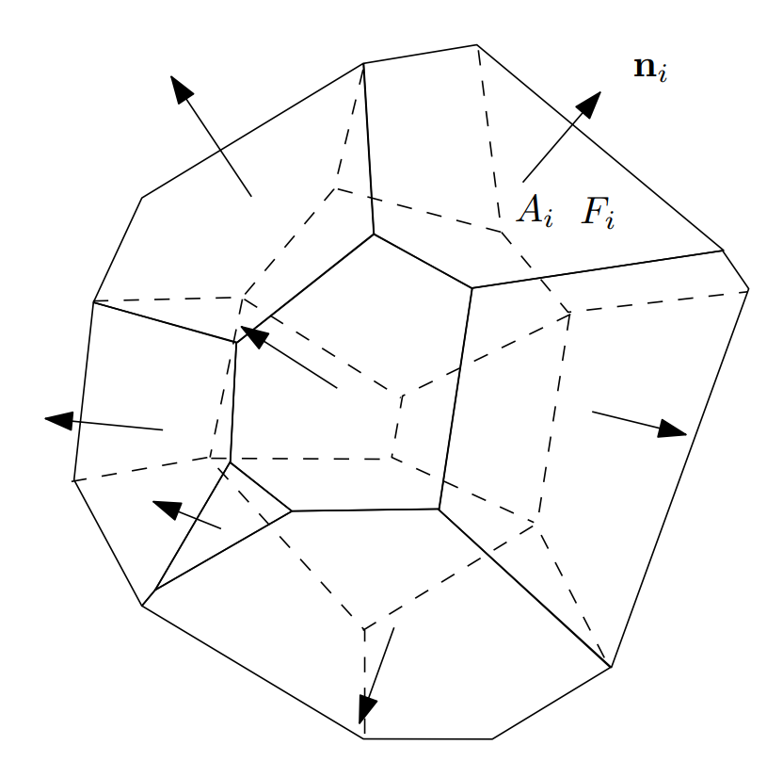
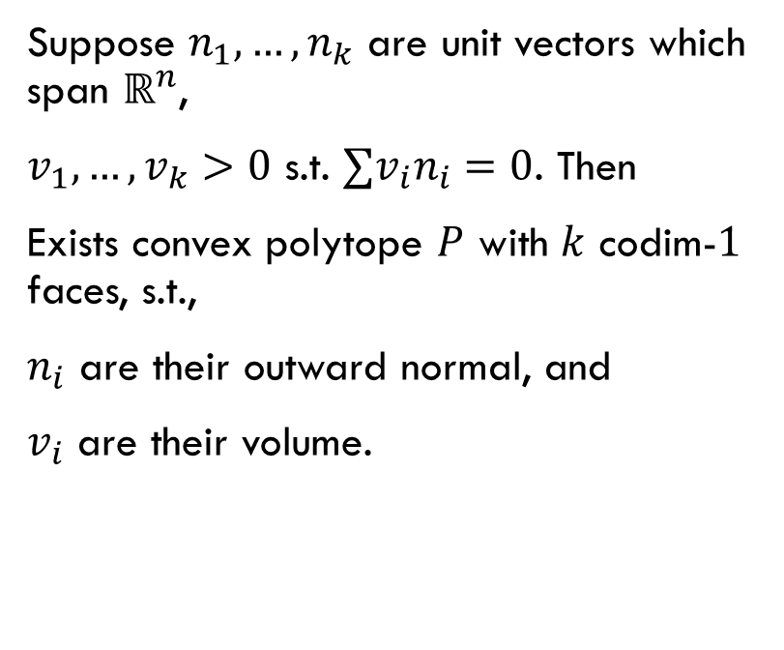
Minkovski problem
Suppose $n_{1},…,n_{k}$ are unit vectors which span $ℝ^{n}$,
$v_{1},…,v_{k}>0$ s.t. $∑v_{i}n_{i}=0$. Then
Exists convex polytope $P$ with $k$ codim-$1$ faces, s.t.,
$n_{i}$ are their outward normal, and
$v_{i}$ are their volume.
Notes:
And solved by Minkovski.
Key:
Given normal and volume
Find that polytope
Note, span condition make it bounded.

Slide 40
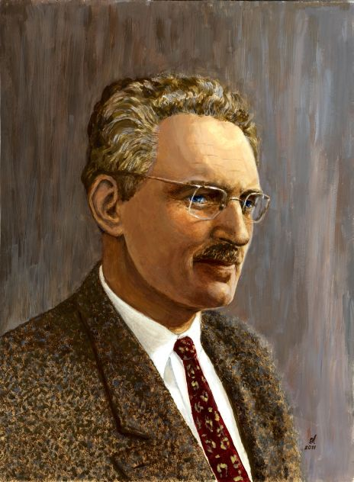
Alexandrov
(August 4, 1912 – July 27, 1999)
Stalin Prize (1942)
Lobachevsky International Prize (1951)
Euler Gold Medal of the Russian Academy of Sciences (1992)
Notes:
A version for unbounded convex polytopes

Slide 41
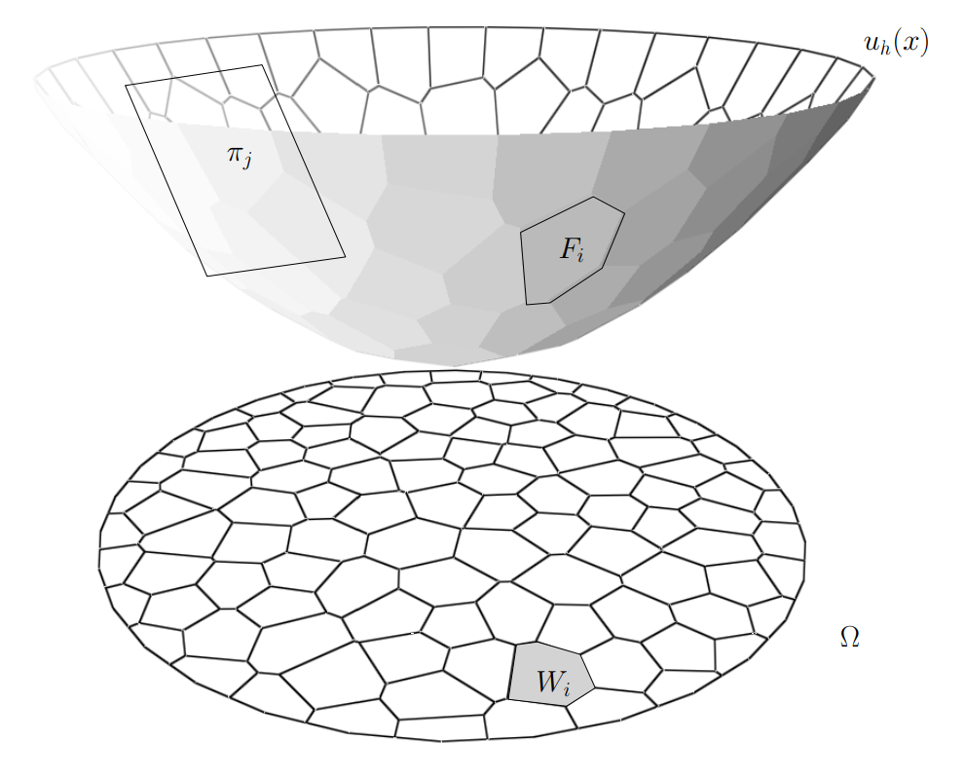
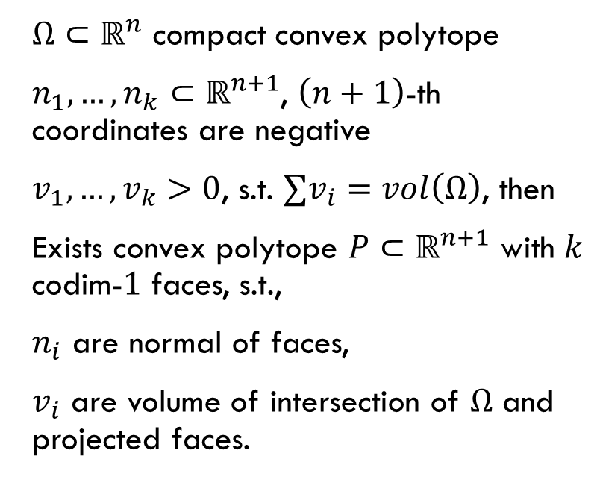
Alexandrov problem
$Ω⊂ℝ^{n}$ compact convex polytope
$n_{1},…,n_{k}⊂ℝ^{n+1}$, $\left(n+1\right)$-th coordinates are negative
$v_{1},…,v_{k}>0$, s.t. $∑v_{i}=vol\left(Ω\right)$, then
Exists convex polytope $P⊂ℝ^{n+1}$ with $k$ codim-$1$ faces, s.t.,
$n_{i}$ are normal of faces,
$v_{i}$ are volume of intersection of $Ω$ and projected faces.
Notes:
Still, given
Normal
Volume
Find an unbounded polytope
Note volume is controlled by another polytope $Ω$ in $ℝ^{n}$, otherwise there are $∞$ areas
Also note normal vectors are in $ℝ^{n+1}$
Proved by Alexandrov and Pogorelov, but not a constructive proof. i.e. no algorithm from proof.

Slide 42
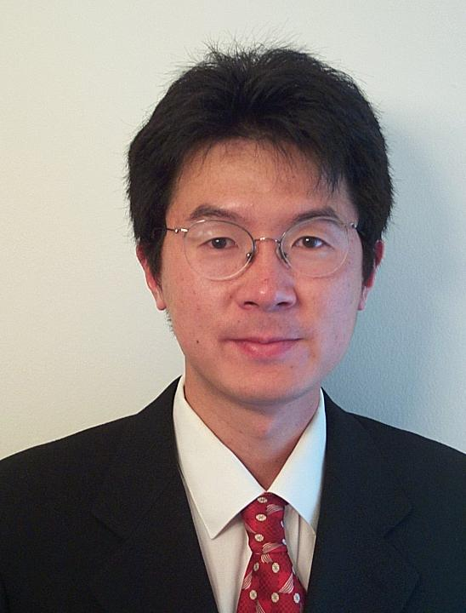
Xianfeng Gu
Associate Professor
Department of Computer Science
Department of Applied Mathematics
State University of New York at Stony Brook

Slide 43
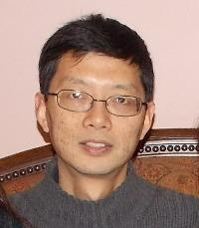
Feng Luo
Professor of Mathematics, Rutgers University

Slide 44
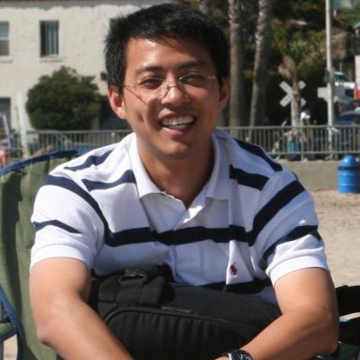
Jian SUn
Associate Professor at Tsinghua University

Slide 45
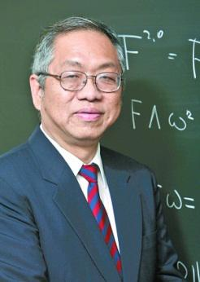
Shing-Tung Yau
(born April 4, 1949)
Director, The Institute of Mathematical Sciences, The Chinese University of Hong Kong
Department of Mathematics, Harvard University
Fields Medal in 1982
Wolf Prize in Mathematics in 2010

Slide 46
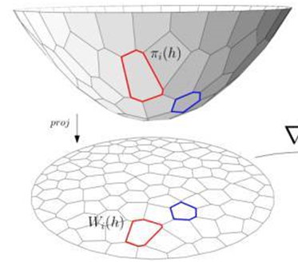
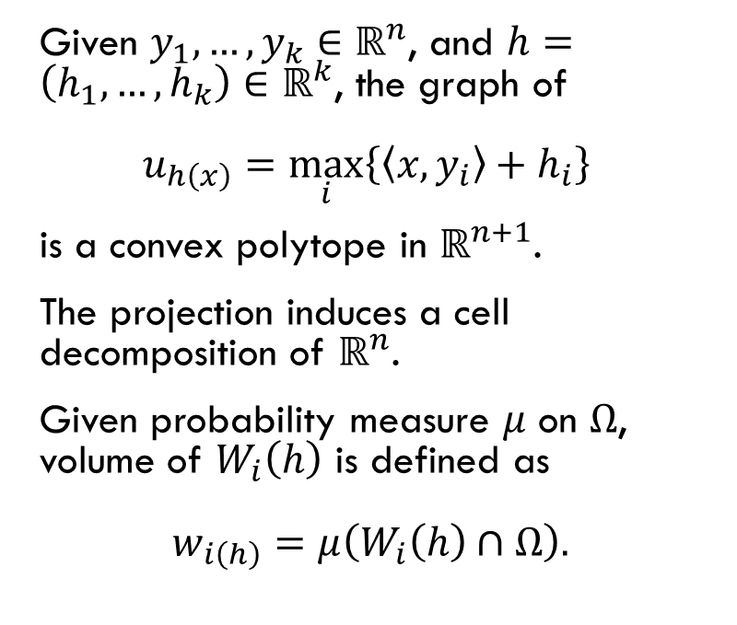
Convex Polytope by Linear function
Given $y_{1},…,y_{k}∈ℝ^{n}$, and $h=\left(h_{1},…,h_{k}\right)∈ℝ^{k}$, the graph of $u_{h\left(x\right)}=\max_{i}\left\{\left\langle x, y_{i}\right\rangle +h_{i}\right\}$
is a convex polytope in $ℝ^{n+1}$.
The projection induces a cell decomposition of $ℝ^{n}$.
Given probability measure $μ$ on $Ω$, volume of $W_{i}\left(h\right)$ is defined as $w_{i\left(h\right)}=μ\left(W_{i}\left(h\right)∩Ω\right).$
Notes:
Unbounded polytope in the form of linear functions.
For given $y_{i}$, only need to specify $h$.

Slide 47
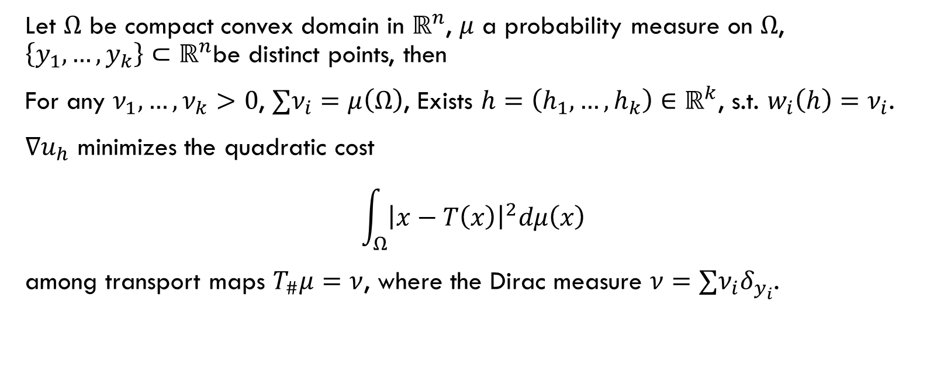
Gu-Luo-Sun-Yau
Let $Ω$ be compact convex domain in $ℝ^{n}$, $μ$ a probability measure on $Ω$, $\left\{y_{1},…,y_{k}\right\}⊂ℝ^{n}$be distinct points, then
For any $ν_{1},…,ν_{k}>0$, $∑ν_{i}=μ\left(Ω\right)$, Exists $h=\left(h_{1},…,h_{k}\right)∈ℝ^{k}$, s.t. $w_{i}\left(h\right)=ν_{i}$.
$∇u_{h}$ minimizes the quadratic cost $\int_{Ω}{{\left|x−T\left(x\right)\right|}^{2}dμ\left(x\right)}$
among transport maps $T_{\#}μ=ν$, where the Dirac measure $ν=∑ν_{i}δ_{y_{i}}$.
Notes:
Still, given
Normal or data points in $ℝ^{n}$
Volume in $ℝ^{n}$
Find optimal graph (determined by $h$)
$Ω$ need not to be a polytope, but any convex domain with a measure.

Slide 48


Semi-discrete optimal mass transport
Geometry
Transportation
Given normal $n_{i}$, and each associate with a volume $ν_{i}$.
Find the convex polytope satisfy normal condition and volume condition.
The convex polytope is determined by the graph of $u_{h}$.
Given target locations $y_{i}$ with probability weight $ν_{i}$.
Find transportation map $T_{\#}μ=ν$.
The transportation map is determined by the Brenier potential $u_{h}$.
Each cell $W_{i}\left(h\right)$ is mapped to $y_{i}$.
Notes:
transport map encodes both the normal condition and the volume condition.

Slide 49

Constructive result
Alexandrov’s proof is non-variational and non-constructive.
Gu-Luo-Sun-Yau’s theorem has a variational proof and produce an algorithm for finding $h$, and thus the Brenier potential $u_{h}$.
In fact, $h$ is the maximum of concave function $E\left(h\right)=\sum_{i=1}^{k}{h_{i}ν_{i}}−\int_{0}^{h}{\sum_{i=1}^{k}{w_{i}\left(η\right)dη}}$
On a open convex set.
Notes:
We do not have time to explain this equation here.

Slide 50
Claims
What Does It Want To Say

Slide 51
Gan in terms of transportation
GAN is a transporting problem from a fixed latent distribution to the data distribution.
The transporting problem is not necessarily to be optimal, but the optimal one is computable.
If in addition, the latent dimension is the same as the data dimension, then we have the observation in the following pages.
Notes:
GAN itself do not require dim of latent and data be same.
But the results of this paper need that.

Slide 52

Optimal transportation map (Brenier Potential)
The generator $g_{θ}$ is equivalent to the optimal transportation map, which is determined by the Brenier potential.
The generator directly generate from fixed latent distribution to data distribution.
Notes:
Optimal transportation map is the gradient of Brenier potential

Slide 53
Wasserstein distance (Kantorovich potential)
This Wasserstein distance is the distance between fixed latent distribution and data distribution.
Regard the Kantorovich potential as “discriminator”, to discriminate between the above two distributions.
Not the same concept of discriminator in GAN.
Notes:
The Wasserstein distance can be computed from the Kantorovich potential.
This discriminator is static. GAN is dynamic in the process of adversarial game.

Slide 54

Generator-“Discriminator” Equivalence
Recall relation between Brenier potential $u$ and Kantorovich potential $ψ$, $∇u=x+{\left(∇h\right)}^{−1}\left(∇ψ\right).$
The generator and “discriminator” determined each other.

Slide 55


Geometric interpretation
Notes:
No time to talk about this.
In trivial case, can be understood as some kind of nearest neighbor.
Power diagram, power distance, Delaunay triangulation

Slide 56


Geometric Generative model
Encoder $f_{θ}:X→Z$
Decoder $g_{ξ}:Z→X$
Empirical distribution $ν=\frac{1}{n}∑δ_{y_{i}}$
$μ={\left(f_{θ}\right)}_{\#}ν=\frac{1}{n}∑δ_{z_{i}}$
$ζ$ a fixed measure on latent space
Probability measure transformation $T:Z→Z, T_{\#}ζ=μ$
Notes:
Do the transportation at latent space.

Slide 57

Learning
Encoding and decoding can use VAE, and the authors do not care about it really.
The probability measure transformation $T$ is of interest.
It is an optimal transportation problem, and can be solved by the constructive results of Gu-Luo-Sun-Yau’s theorem.
Notes:
Not really interesting.
GAN was first proposed to replace generative models like VAE.

Slide 58
Relation with Wgan
Both paper contains the word “Wasserstein”.

